Slide 1
Network Programming
K Hari Babu
Department of Computer Science & Information Systems

Slide 2
Outline

Slide 3
Outline
Socket Options
UDP Sockets
Client
Server
Connect() call
TCP or UDP?
Domain Name Conversion
get hostbyname()
getaddrinfo()

Slide 4
Socket Options

Slide 5
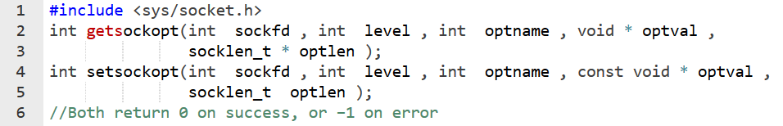
Socket Options
Socket options affect various features of the operation of a socket.
sockfd - socket descriptor
level - system layer that interprets the option
general socket (SOL_SOCKET),
protocol specific (IPPROTO_IP, IPROTO_TCP, etc.)
optname - name of the option
optval - value of the option
optlen - length of the option value

Slide 6
Socket Options (2)
Two types of options
Flag - binary option that enables or disables a feature
Value - can be integer, char, struct timeval, and more
Levels of socket options
General SOL_SOCKET
SO_BROADCAST, SO_DONTROUTE, SO_KEEPALIVE, SO_LINGER, SO_RCVBUF, SO_SNDBUF
IP, ICMP, IPV6, ICMPV6
IP_HDRINCL, IP_TOS, IP_TTL, IP_MULTICAST_TTL
TCP
TCP_MAXSEG, TCP_NODELAY

Slide 7
Generic Socket Options (1)
SO_BROADCAST
Enabling a process to send broadcast packets
UDP type datagram sockets only, no connection-oriented sockets
works if supported by network (e.g. ethernet)
SO_DONTROUTE
Bypassing normal routing mechanisms
Used by routing daemons, such as gated or routed
SO_KEEPALIVE

Slide 8
SO_KEEPALIVE
Normally used by servers, but it is not part of the standard
When the connection is idle and the peer host crashes or becomes unreachable, setting this option sends out 9 keepalive probes after 2 hours of inactivity
Probes are sent 75 seconds apart, and can only be changed as a system parameter
Peer responds with the expected ACK
Another probe will be sent after another 2 hours
Peer responds with an RST
Socket is closed and error set to ECONNRESET
Peer does not respond
Another probe is sent after 75 seconds
If there is no response to all the probes, socket is closed with error set to ETIMEDOUT or EHOSTUNREACH

Slide 9
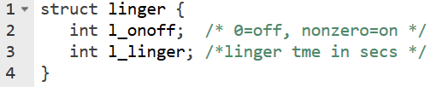
SO_LINGER
no linger – graceful shut
Only TCP close() is affected by SO_LINGER
Case 1: linger->l_onoff is zero (linger->l_linger has no meaning)… This is the default. Close will return immediately. On close(), the underlying stack attempts to gracefully shutdown the connection after ensuring all unsent data is sent. In the case of connection-oriented protocols such as TCP, the stack also ensures that sent data is acknowledged by the peer. The stack will perform the above-mentioned graceful shutdown in the background (after the call to close() returns), regardless of whether the socket is blocking or non-blocking.
Case 2: linger->l_onoff is non-zero and linger->l_linger is zero: A close() returns immediately. The underlying stack discards any unsent data, and, in the case of connection-oriented protocols such as TCP, sends a RST (reset) to the peer (this is termed a hard or abortive close). All subsequent attempts by the peer's application to read()/recv() data will result in an ECONNRESET.
Case 3: linger->l_onoff is non-zero and linger->l_linger is non-zero: A close() will either block (if a blocking socket) or fail with EWOULDBLOCK (if non-blocking) until a graceful shutdown completes or the time specified in linger->l_linger elapses (time-out). Upon time-out the stack behaves as in case 2 above.
linger 0 time - abort
linger some time

Slide 10
Generic Socket Option (5)
SO_RCVBUF
Each socket has a receiver buffer
Changes the receiver buffer size
The timing of setting this option is important
SO_SNDBUF
TCP socket has a send buffer but UDP socket does not
For TCP, SO_SNDBUF changes the send buffer size
For UDP, SO_SNDBUF limits the maximum UDP datagram size

Slide 11
Generic Socket Options (6)
SO_RCVLOWAT
Each socket has a receive low-water mark
Amount of data that must be in the socket receive buffer before select() returns “readable”
SO_SNDLOWAT
Each socket has a send low-water mark
Amount of space that is available in the socket send buffer before select() returns “writable”

Slide 12
Generic Socket Options (7)
SO_REUSEADDR
Allows a listening server to start and bind its well-known port, even if previously established connections exist that use the same port as their local port
when a server restarts while previous child is still alive
Allows a new server to be started on the same port as an existing server that is bound to the wildcard address, as long as each instance binds to a different local IP address
multiple servers can reside on the same machine as long as each server has a different local ip address
Security concerns of SO_REUSEADDR
some systems do not allow specific binding to happen AFTER wildcard binding
avoid rogue server to attach to existing services

Slide 13
IPv4 Socket Options
IP_HDRINCL
Set for a raw IP socket
The program can build its own IP header for all the datagrams sent on the raw socket
Raw sockets
Read and write ICMP and IGMP packets
Read and write IPv4 datagrams with an IPv4 protocol field not processed by the kernel
OSPF (89)
Build its own IP header using IP_HDRINCL socket option

Slide 14
TCP Socket Options
TCP_MAXSEG
Fetch and set the TCP Maximum Segment Size
TCP_NODELAY
If set, disables TCP Nagle algorithm
TCP Nagle algorithm states that if a given connection has outstanding data (sent but not acknowledged), then no small packets will be sent on the connection
Reduces the number of small packets

Slide 15
UDP Sockets

Slide 16
UDP Sockets
If TCP communication is compared to making a telephone call, UDP communication is compared to posting a letter.
Connectionless
Unreliable
Datagram protocol
Popular applications
DNS(the Domain Name System)
NFS(the Network File System)
SNMP(Simple Network Management Protocol)
Multimedia
Just as with the postal system, when multiple datagrams (letters) are sent from one address to another, there is no guarantee that they will arrive in the order they were sent, or even arrive at all.

Slide 17
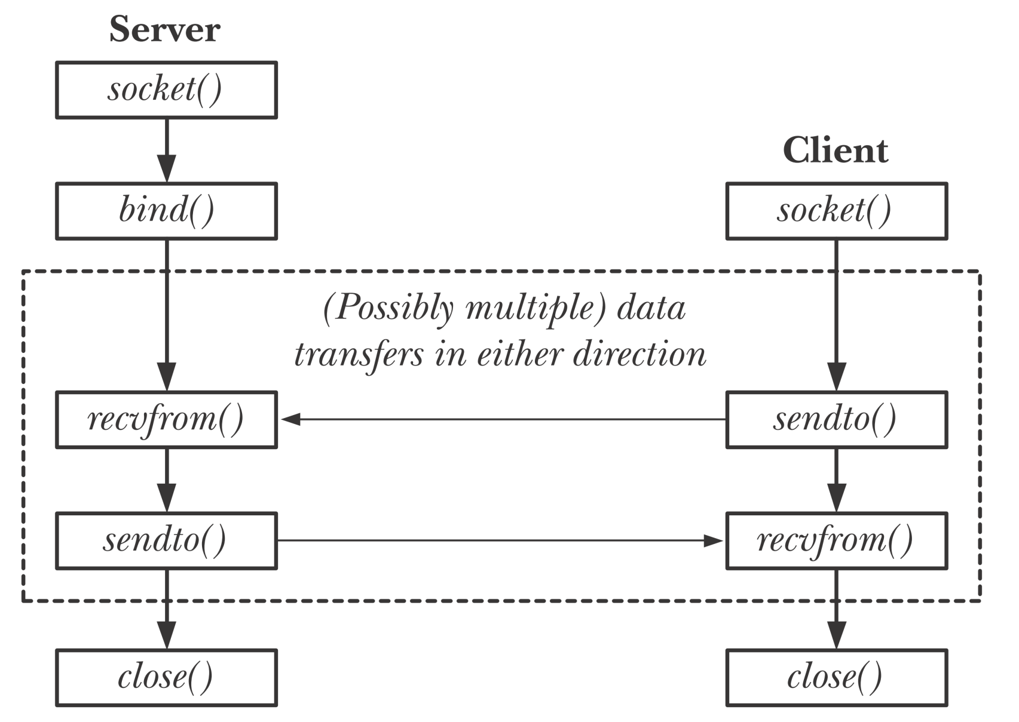
UDP Client Server

Slide 18
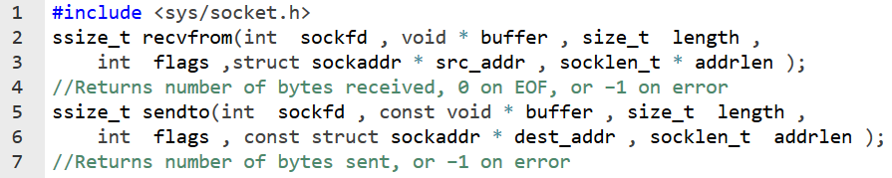
Exchanging Messages
The recvfrom() and sendto() system calls receive and send datagrams (one at a time) on a datagram socket.
The return value and the first three arguments to these system calls are the same as for read() and write().
Final two arguments of recvfrom() and sendto() are similar to the final two arguments in accept() and connect().

Slide 19
Recfrom() & sendto()
Both functions return the length of data that was written or read.
Writing a datagram of length 0 is acceptable.
IP+UDP header + no app layer data.
recvfrom() can return 0.
This is not same as read() returning 0.
0 is the length of datagram.
Regardless of the value specified for length, recvfrom() retrieves exactly one message from a datagram socket.
If the size of that message exceeds length bytes, the message is silently truncated to length bytes.
Using rcvmsg(), MSG_TRUNC flag can be used to detect this.

Slide 20

UDP Client-Server
We will use echo protocol.
Server
Create UDP socket & bind at well-known port number.
Read datagram and echo back to sender
Client
Create UDP Socket
Read from stdin and send datagram to server
Read from UDP socket and write to stdout.

Slide 21
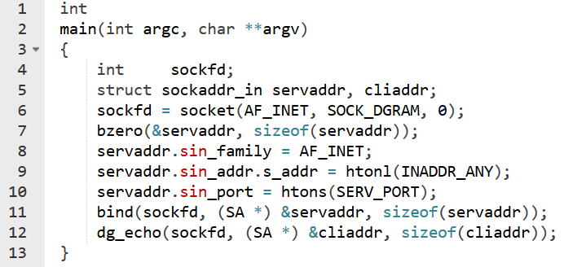
UDP Server
UDP socket is created by specifying the second arg as SOCk_DGRAM.

Slide 22
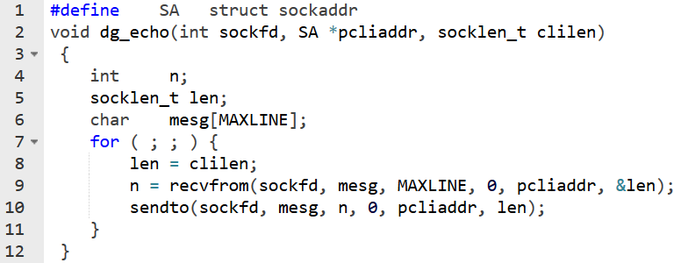
UDP Server
This function never terminates.
Since UDP is connectionless protocol, there is nothing like an EOF as in TCP.

Slide 23
UDP Server
What we discussed is an iterative server.
Client requests are handled one after another. There is no call to fork().
In general most TCP servers are concurrent, and most UDP servers are iterative.
UDP socket has a receive buffer. Incoming datagrams are queued there.
When server calls recvfrom(), a datagram is returned in FIFO order.
Buffer has a limited size (default 40000bytes).

Slide 24
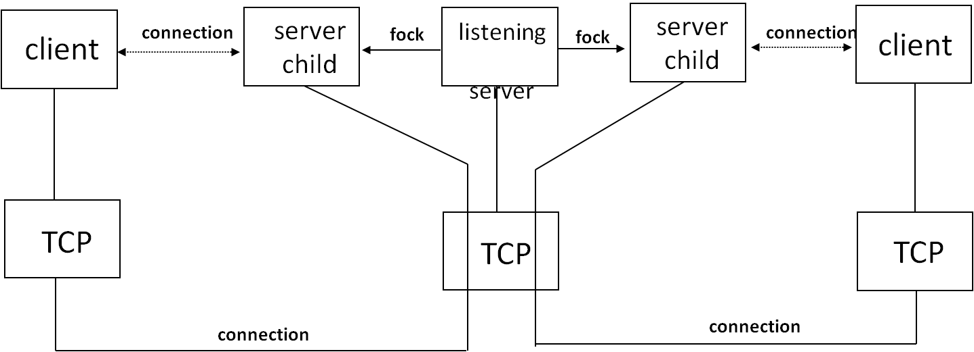
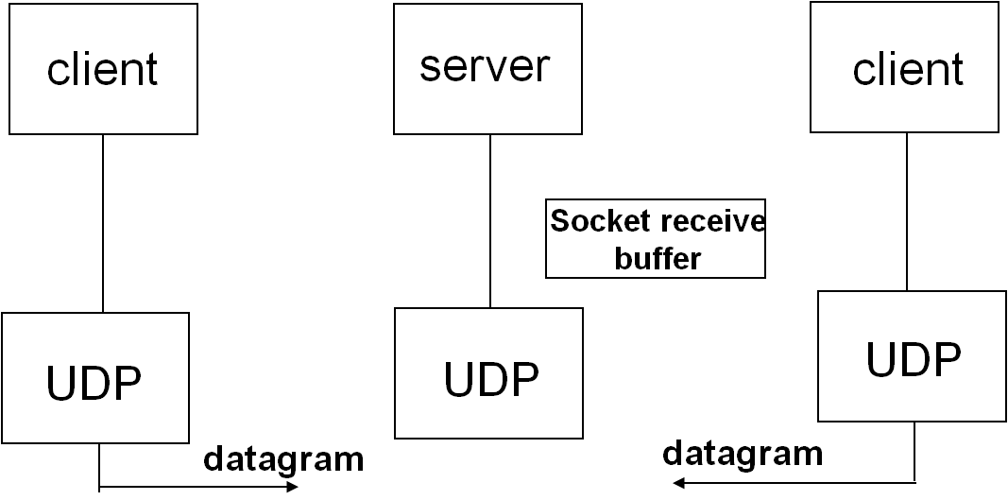
TCP Server vs UDP Server
In TCP server, there is connected socket for each client and there is separate buffer in each socket.
In UDP server, datagrams from all clients are placed in a single buffer. No separate socket for each client.

Slide 25
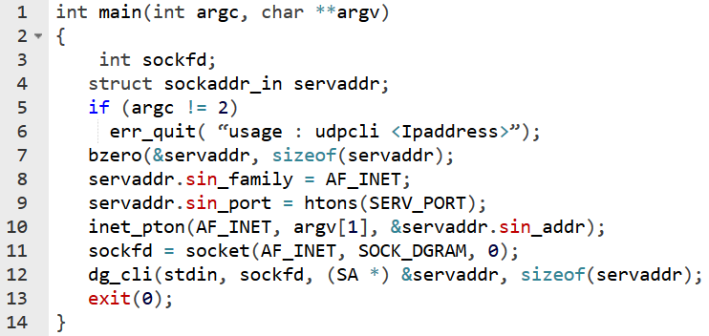
UDP Client
When client uses sendto() at that kernel allocates an ephemeral port to the socket local endpoint.

Slide 26
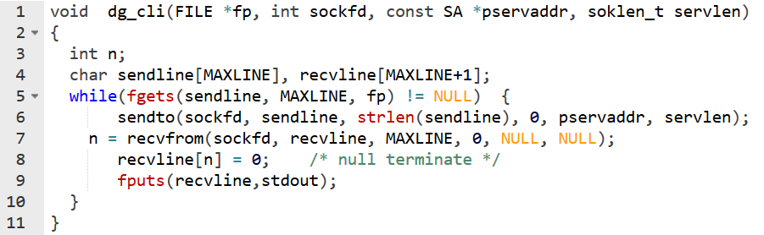
UDP Client
In recvfrom() last two arguments are specified as NULL. This tells the kernel that we are not interested in knowing who sent the reply.

Slide 27
Lost Datagrams
If the clients datagram is lost to the server, server will wait indefinitely on recvfrom().
If the server’s datagram to client is lost, then client will wait indefinitely on recvfrom().
Solution:
Put a timeout . But this will not tell whether client’s datagram is lost or server’s reply is lost.
Use timers
Use application level reliability support.
Sequence numbers
Acknowledgements
Timeout & retransmission

Slide 28
UDP Sockets & Asynchronous Errors
Client sendto() returns successfully after writing a datagram to UDP socket send buffer.
But due to some reason say “Server Not Running”, the server host will send ICMP “port unreachable” error.
This error or “network unreachable” or “host unreachable” are asynchronous errors.
The basic rule is that an asynchronous error is not returned for a UDP socket unless the socket has been connected.
Reason:
An unconnected Udp socket can be used to send datagrams to multiple destinations. If error is received, then Udp can return only errno but not which destination.
Therefore only connected UDP socket receives asynch errors.

Slide 29
Connected UDP Sockets
Calling connect() on a datagram socket causes the kernel to record a particular address as this socket’s peer.
This does not result in anything like a TCP connection: there is no three-way handshake. Instead, the kernel just records the IP address and port number of the peer.
With a connected UDP socket, three changes:
We can no long specify the destination IP address and port for an output operation. That is, we do not use sendto() but use write or send instead.
We do not use recvfrom but read or recv instead.
Asynchronous errors are returned to the process for a connected UDP socket.
Only datagrams sent by the peer socket may be read on the socket.

Slide 30
Using connect() Multiple Times
A process with a connected UDP socket can call connect again for that socket for one of two reasons:
To specify a new IP address and port
To unconnect the socket
connect can be called only one time for a TCP socket. But in UDP, it can be called multiple times with different peer addresses.
To unconnect a UDP socket, we call connect but set the family member of the socket address structure (sin_family for IPv4 or sin6_family for IPv6) to AF_UNSPEC.

Slide 31
UDP datagram size & IP fragmentation
IP fragmentation occurs transparently to higher protocol layers, but nevertheless is generally considered undesirable.
IP doesn’t perform retransmission
A datagram can be reassembled at the destination only if all fragments arrive
The entire datagram is unusable if any fragment is lost or contains transmission errors.
In some cases, this can lead to significant rates of data loss (for UDP) or degraded transfer rates (for TCP).
Modern TCP implementations employ algorithms (path MTU discovery) to determine the MTU of a path between hosts.

Slide 32
UDP datagram size & IP fragmentation
A UDP-based application generally doesn’t know the MTU of the path between the source and destination hosts.
UDP-based applications that aim to avoid IP fragmentation typically adopt a conservative approach.
The transmitted IP datagram is less than the IPv4 minimum reassembly buffer size of 576 bytes.
This value is likely to be lower than the path MTU.
576- 20(IPv4) -8 (UDP header) = 548 bytes.
In practice, many UDP-based applications opt for a still lower limit of 512 bytes for their datagrams.

Slide 33
TCP vs UDP?

Slide 34
When to use UDP instead of TCP?
Advantages of UDP:
UDP supports broadcasting and multicasting
UDP has no connection setup or teardown
For a two packet request-reply, we need 8 extra packets to be transmitted in TCP
UDP: RTT+SPT, TCP: 2 *RTT + SPT
Features of TCP not provided by UDP:
Positive acknowledgments, retransmission of lost packets, duplicate detection, and sequencing of packets reordered by the network
Seq nos, estimate RTO
Windowed flow control
Slow start and congestion avoidance
to determine the current network capacity and to handle periods of congestion

Slide 35
When to use UDP instead of TCP?
Recommendations:
UDP must be used for broadcast and multicast applications
Error control or reliability be added if reqd at appl layer
UDP can be used for simple request-reply applications, but error detection must be built into the application
Acknowledgements, timeouts, retransmissions
UDP should not be used for bulk data transfer
Bulk transfer requires flow control along with error control which is like replicating TCP at appl layer
Certain types of applications (e.g., streaming video and audio transmission) can function acceptably without the reliability provided by TCP.
Delays by TCP retires may be worse than losing a part of the stream.
Use UDP and adopt application-specific recovery strategies due to occasional packet loss.

Slide 36
Name and Address Conversions (T1: 11, R1: 59.8)

Slide 37
DNS
Two functions which we use to convert a domain name to IP address:
gethostbyname() - obsolete
getaddrinfo() - supports both IPv6 and IPv4
The DNS is used primarily to map between hostnames and IP addresses.
A hostname can be either a simple name, such as solaris or freebsd, or a fully qualified domain name (FQDN), such as solaris.unpbook.com.
Before DNS, mappings between hostnames and IP addresses were defined in a manually maintained local file, /etc/hosts

Slide 38
DNS
The /etc/hosts scheme scales poorly.
DNS was devised to address this problem.
Hostnames are organized into a hierarchical namespace.
Node in the DNS hierarchy has a label (name), which may be up to 63 characters.
At the root of the hierarchy is an unnamed node, the “anonymous root.”
A node’s domain name consists of all of the names from that node up to the root concatenated together, with each name separated by a period ( . )
No single organization or system manages the entire hierarchy.
Instead, there is a hierarchy of DNS servers, each of which manages a branch (a zone) of the tree.
For adding a host, admin has to add it to local name server.
DNS servers employ caching techniques to avoid unnecessary communication for frequently queried domain names.

Slide 39
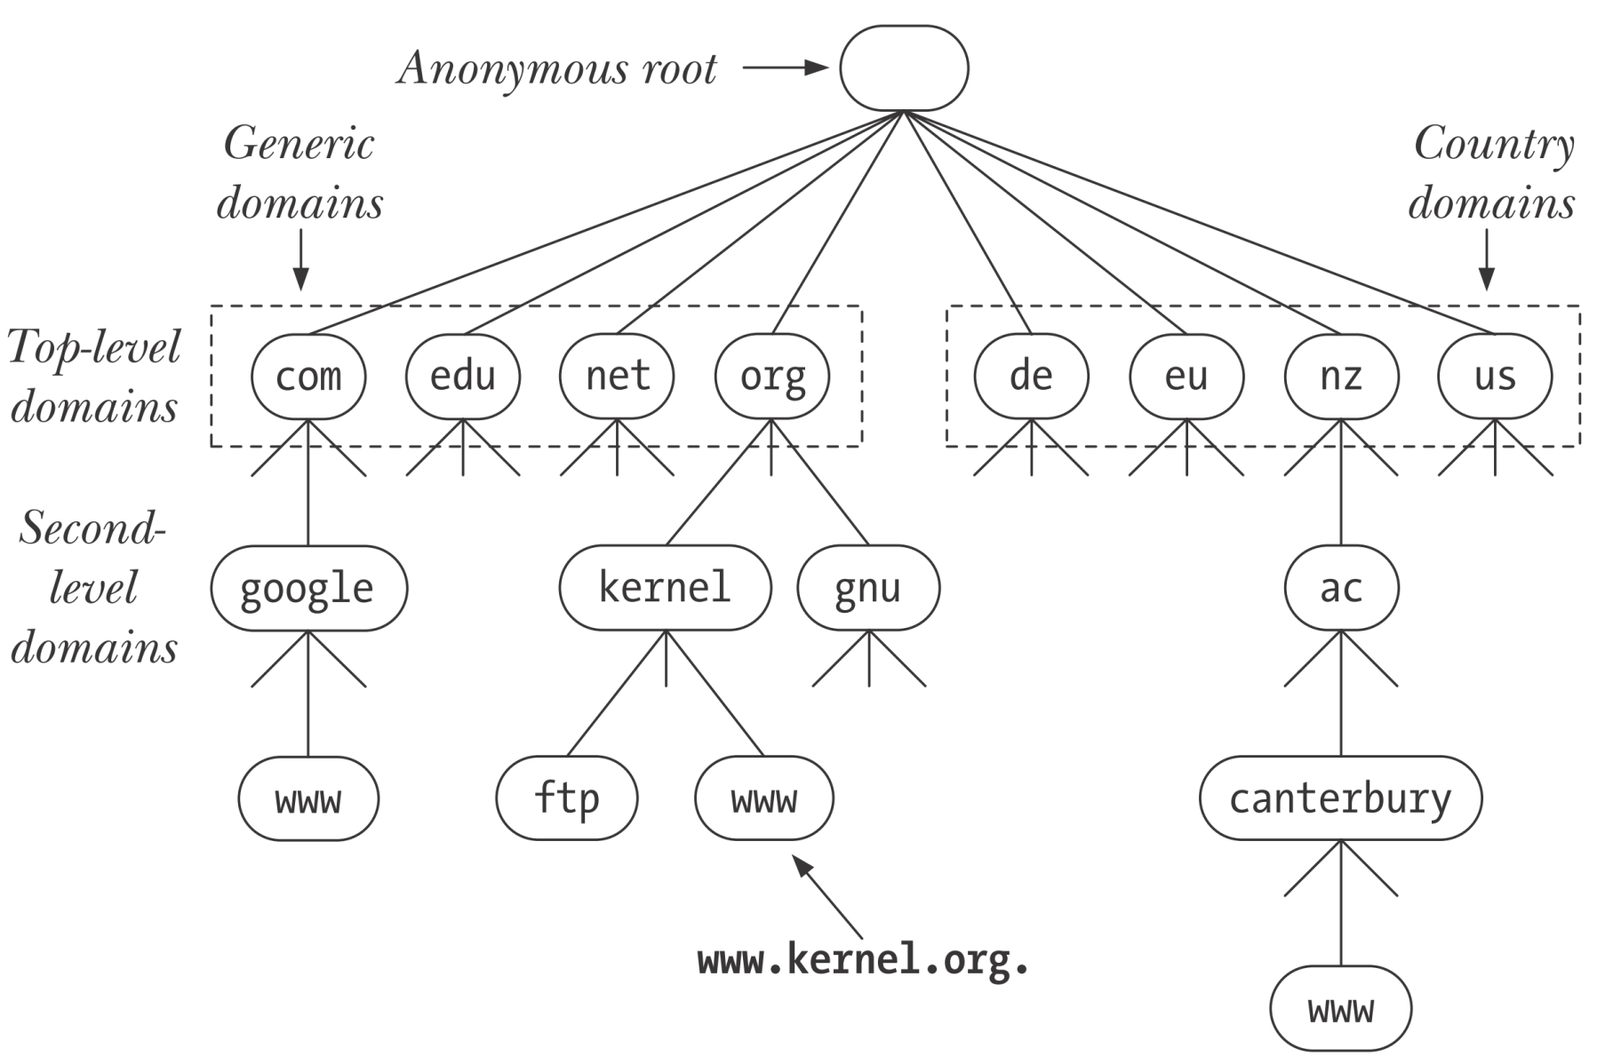
DNS

Slide 40
DNS Lookup
Not every name server knows about every other name server.
Name server must know the IP address of root servers.
Root servers know the name and location for all second-level domains.

Slide 41
Recursive and Iterative Lookups
DNS resolution requests fall into two categories: recursive and iterative.
In a recursive request, the requester asks the server to handle the entire task of resolution.
When an application on the local host calls getaddrinfo(), that function makes a recursive request to the local DNS server.
If the local DNS server does not itself have the information to perform the resolution, it resolves the domain name iteratively.

Slide 42
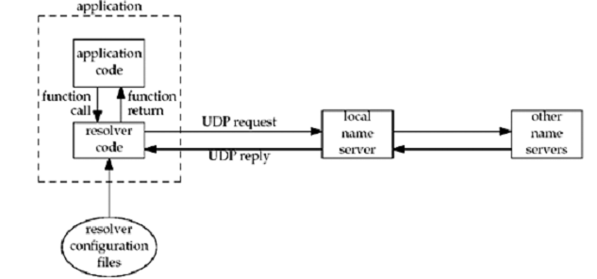
Resolvers and Name Servers
Resolver is part of the application

Slide 43
The /etc/services File
Well-known port numbers are centrally registered by IANA.
Each of these ports has a corresponding service name.
Because service numbers are centrally managed and are less volatile than IP addresses, an equivalent of the DNS server is usually not necessary. Instead, the port numbers and service names are recorded in the file /etc/services .
The getaddrinfo() and getnameinfo() functions use the information in this file to convert service names to port numbers and vice versa.

Slide 44
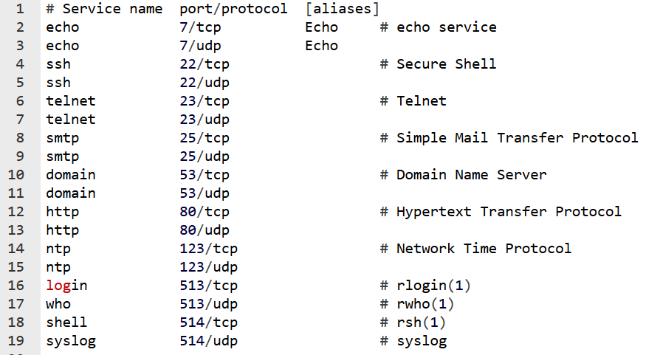
The /etc/services File

Slide 45
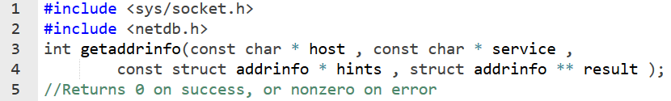
Host and Service Conversion
The getaddrinfo() function converts host and service names to IP addresses and port numbers.
successor to the obsolete gethostbyname() and getservbyname() functions
Given a host name and a service name, getaddrinfo() returns a list of socket address structures, each of which contains an IP address and port number.

Slide 46
The getaddrinfo() Function
As input, getaddrinfo() takes the arguments host, service, and hints.
Host:
It can be hostname or numeric address string 172.24.2.19
Service:
This contains either service name or port number.
Hints:
The hints argument points to an addrinfo structure that specifies further criteria for selecting the socket address structures returned via result.

Slide 47
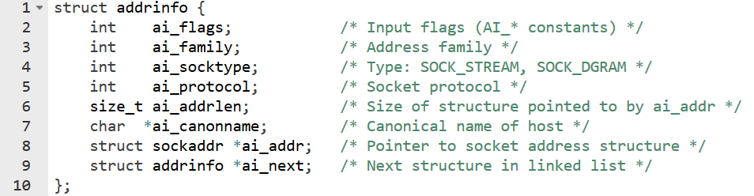
Addrinfo structure
As output, getaddrinfo() dynamically allocates a linked list of addrinfo structures and sets result pointing to the beginning of this list.
Each of these addrinfo structures includes a pointer to a socket address structure corresponding to host and service.

Slide 48
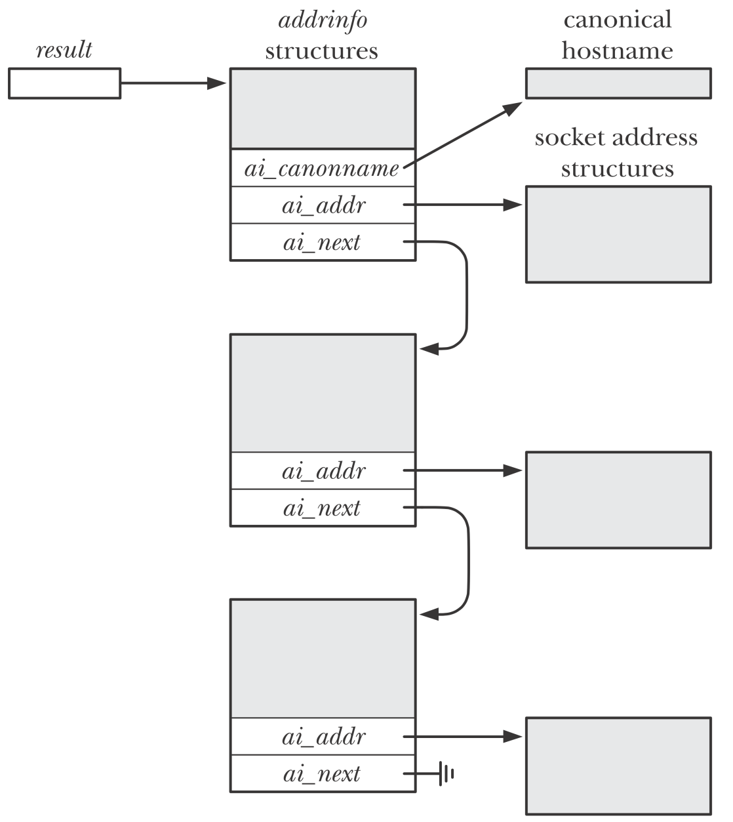
Result

Slide 49
The hints Argument
Hints is either a null pointer or a pointer to an addrinfo structure.
the caller fills in this structure with hints about the types of information the caller wants returned.
The members of the hints structure that can be set by the caller are:
ai_flags (zero or more AI_XXX values OR'ed together)
ai_family (an AF_xxx value)
ai_socktype (a SOCK_xxx value)
ai_protocol
For example,
if the specified service is provided for both TCP and UDP, set ai_socktype member of the hints structure to SOCK_DGRAM. Then only information returned will be for datagram sockets.

Slide 50
The hints Argument
AI_PASSIVE
The caller will use the socket for a passive open.
AI_CANONNAME
Tells the function to return the canonical name of the host.
AI_NUMERICHOST
Prevents any kind of name-to-address mapping; the hostname argument must be an address string.
AI_NUMERICSERV
Prevents any kind of name-to-service mapping; the service argument must be a decimal port number string.
AI_V4MAPPED
If specified along with an ai_family of AF_INET6, then returns IPv4-mapped IPv6 addresses corresponding to A records if there are no available AAAA records.

Slide 51
The hints Argument
Returns linked list of addrinfo structures, linked through the ai_next pointer.
There are two ways that multiple structures can be returned:
Multiple ips per hostname; one sockaddr structure for each ip
Service is provided for multiple socket types; SOCK_STREAM or SOCK_DGRAM
For example, if no hints are provided and if the domain service is looked up for a host with two IP addresses, four addrinfo structures are returned:
One for the first IP address and a socket type of SOCK_STREAM
One for the first IP address and a socket type of SOCK_DGRAM
One for the second IP address and a socket type of SOCK_STREAM
One for the second IP address and a socket type of SOCK_DGRAM

Slide 52
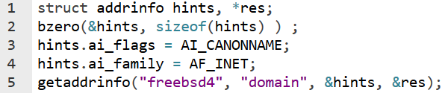
Example
Consider the following code

Slide 53
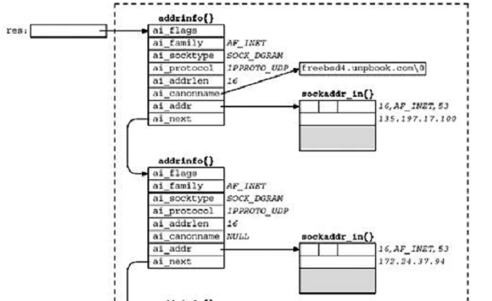
Result
Base pointer
to linked list

Slide 54
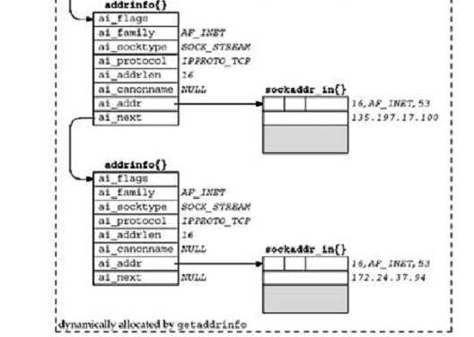
Result

Slide 55
Usage
Sockaddr structure in addrinfo structures is ready for
a call to socket
then either a call to connect or sendto (for a client), or bind (for a server).
The arguments to socket are the members ai_family, ai_socktype, and ai_protocol.
The second and third arguments to either connect or bind are ai_addr, and ai_addrlen

Slide 56
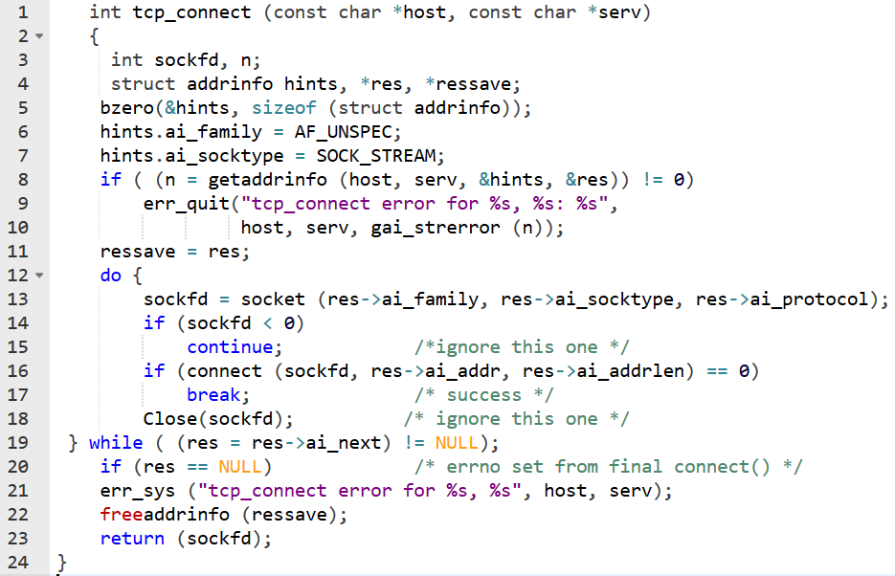
On client side

Slide 57
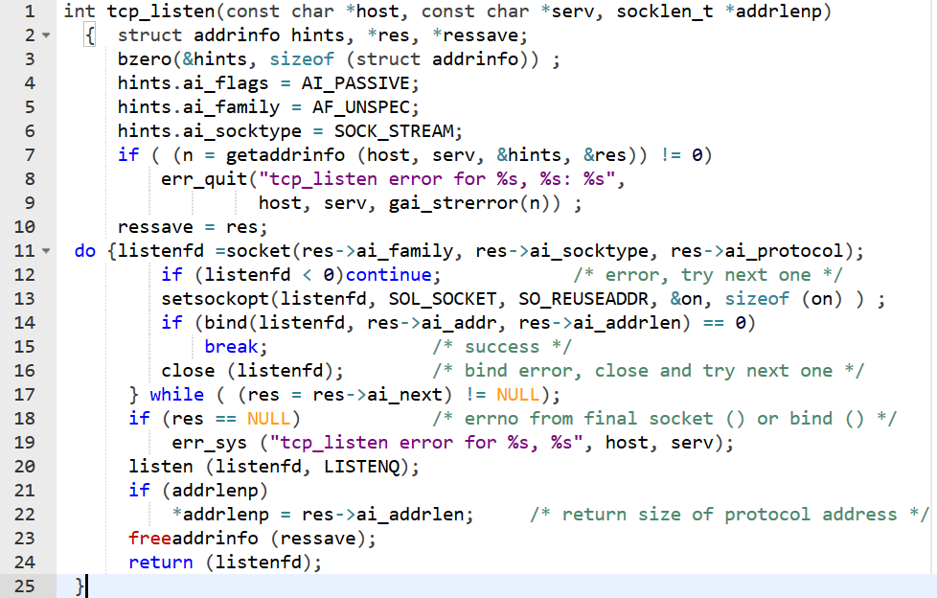
Server side usage

Slide 58
Acknowledgements

Slide 59
Q&A

Slide 60
Thank You

